Slide 1
UNIT – 2
SIGNAL DISTORTION IN
OPTICAL FIBERS

Slide 2
Introduction
One of the important property of optical fiber is signal attenuation. It is also known as fiber loss or signal loss.
The signal attenuation of fiber determines the maximum distance
between transmitter and receiver.
The attenuation also determines the number of repeaters required, maintaining repeater is a costly affair.
Another important property of optical fiber is distortion mechanism.
As the signal pulse travels along the fiber length it becomes more broader. After sufficient length the broad pulses starts overlapping with adjacent pulses.
This creates error in the receiver. Hence the distortion limits the information carrying capacity of fiber.

Slide 3
Attenuation
Attenuation is a measure of decay of signal strength or loss of light power
that occurs as light pulses propagate through the length of the fiber.
In optical fibers the attenuation is mainly caused by two physical factors absorption and scattering losses. Absorption is because of fiber material and scattering due to structural imperfection within the fiber. Nearly 90 % of total attenuation is caused by Rayleigh scattering only. Micro bending of optical fiber also contributes to the attenuation of signal.
The rate at which light is absorbed is dependent on the wavelength of the light and the characteristics of particular glass. Glass is a silicon compound, by adding different additional chemicals to the basic silicon dioxide the optical properties of the glass can be changed.
The Rayleigh scattering is wavelength dependent and reduces rapidly as the wavelength of the incident radiation increases.
The attenuation of fiber is governed by the materials from which it is fabricated, the manufacturing process and the refractive index profile chosen. Attenuation loss is measured in dB/km.

Slide 4
Attenuation Units
As attenuation leads to a loss of power along the fiber, the output power is significantly less than the couples power.
Let the couples optical power is p(0) i.e. at origin (z = 0). Then the power
at distance z is given by,
P(z) = P(0) e^{−αp Z}
Where αp is the fiber attenuation constant (per km)
₌ 1 _{ln} ⎡ P(0) ⎤
α
P
z ⎢ P(Z ) ⎥
⎣ ⎦
1 ⎡ P(0) ⎤
α
= 10. .log⎢ ⎥
z P(Z )
(dB/ km)
⎣ ⎦
This parameter is known as Fiber loss or Fiber Attenuation

Slide 5
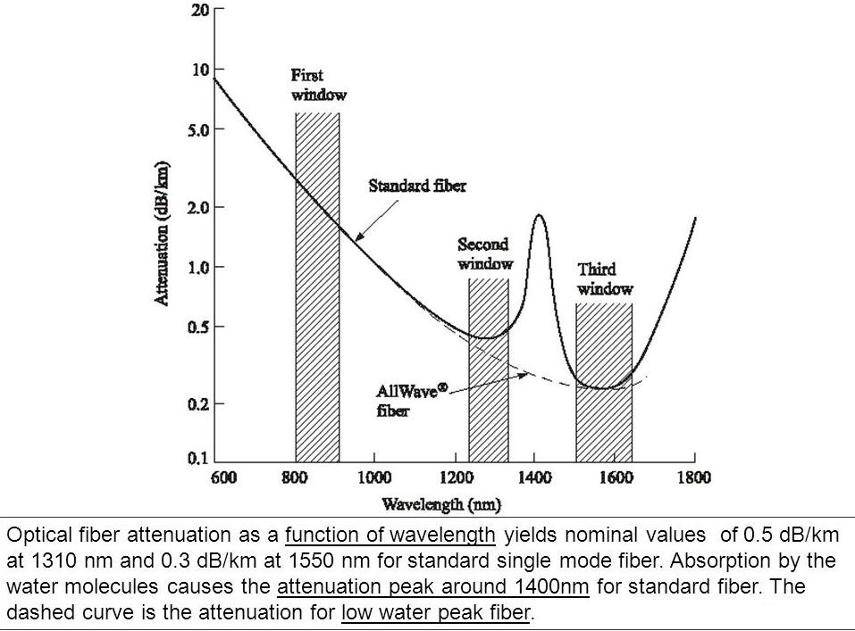
Attenuation is also a function of wavelength. Optical fiber wavelength as
a function of wavelength is shown in Fig

Slide 6
Absorption
Absorption loss is related to the material composition and fabrication process of fiber.
Absorption loss results in dissipation of some optical power as heat in the fiber cable. Although glass fibers are extremely pure, some impurities still remain as residue after purification.
The amount of absorption by these impurities depends on their
concentration and light wavelength.
Absorption is caused by three different mechanisms:
Absorption by atomic defects in glass composition.
Extrinsic absorption by impurity atoms in glass mats.
Intrinsic absorption by basic constituent atom of fiber.

Slide 7
Absorption by Atomic Defects
Atomic defects are imperfections in the atomic structure of the fiber materials such as missing molecules, high density clusters of atom groups.
These Absorption losses are negligible compared with intrinsic and extrinsic losses.
The absorption effect is most significant when fiber is exposed to ionizing radiation in nuclear reactor, medical therapies, space missions etc.
The radiation damages the internal structure of fiber. The damages are proportional to the intensity of ionizing particles. This results in increasing attenuation due to atomic defects and absorbing optical energy.

Slide 8
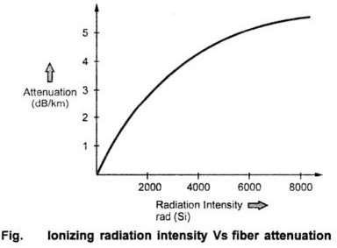
rad (Si), this is the unit for measuring radiation absorbed in bulk silicon

Slide 9
Extrinsic Absorption
Extrinsic absorption occurs due to electronic transitions between the energy level and because of charge transitions from one ion to another.
A major source of attenuation is from transition of metal impurity ions such as iron, chromium, cobalt and copper. These losses can be up to 1 to 10 dB/km. The effect of metallic impurities can be reduced by glass refining techniques.
Another Major Extrinsic loss is caused by absorption due to OH (Hydroxil)
ions impurities dissolved in glass. Vibrations occur at wavelengths between
2.7 and 4.2 μm. The absorption peaks occurs at 1400, 950 and 750 nm. These are first, second and third overtones respectively.

Slide 10
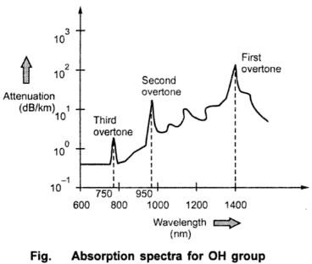

Slide 11
Intrinsic Absorption
Intrinsic absorption occurs when material is in absolutely pure state, no density variation and inhomogenities. Thus intrinsic absorption sets the fundamental lower limit on absorption for any particular material.
Intrinsic Absorption Results from Electronic absorption Bands in UV
Region and from atomic vibration bands in the near infrared region.
The electronic absorption bands are associated with the band gaps of amorphous glass materials. Absorption occurs when a photon interacts with an electron in the valence band and excites it to a Higher Energy level.
UV absorption Decays Exponentially With increasing wavelength (λ).

Slide 12
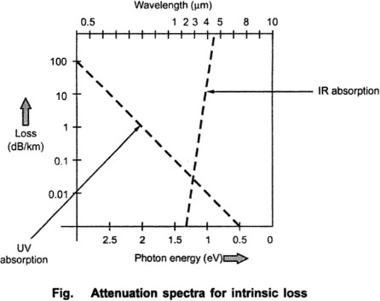
In the IR (infrared) region above 1.2 μm the optical waveguide loss is determined by presence of the OH ions and inherent IR absorption of the constituent materials.
The inherent IR absorption is due to interaction between the vibrating band and the electromagnetic field of optical signal this results in transfer of energy from field to the band, thereby giving rise to absorption, this absorption is strong because of many bonds present in the fiber.

Slide 13
The ultraviolet loss at any wavelength is expressed as,
Where,
x is mole fraction of GeO₂. λ is operating wavelength α_{uv} is in dB/km
The loss in infrared (IR) region (above 1.2 µm) is given by expression :
The expression is derived for GeO₂ – SiO₂ glass fiber.

Slide 14
Scattering Losses
Scattering losses exists in optical fibers because of microscopic variations in the material density and composition.
As glass is composed by randomly connected network of molecules and several oxides (e.g. SiO2, GeO2 and P2O5), these are the major cause of compositional structure fluctuation.
These two effects results to variation in refractive index and Rayleigh type scattering of light.
There are two types of Scattering:
Rayleigh Scattering
MIE Scattering

Slide 15
Rayleigh Scattering Losses
Rayleigh scattering of light is due to small localized changes in the refractive index of the core and cladding material. There are two causes during the manufacturing of fiber.
The first is due to Slight fluctuation in mixing of ingredients. The Random
changes because of this are impossible to eliminate completely.
The other cause is slight change in density as the silica cools and solidifies. When light ray strikes such zones it gets scattered in all directions. The amount of scatter depends on the size of the discontinuity compared with the wavelength of the light so the shortest wavelength (highest frequency) suffers most scattering. Fig. shows graphically the relationship between wavelength and Rayleigh scattering loss.

Slide 16
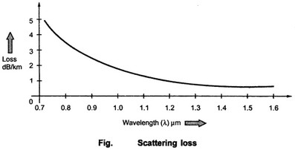
Scattering loss for single component glass is given by,
Where,
n = Refractive index
k = Boltzmann's constant
β_{T} = Isothermal compressibility of material
T_{f} = Temperature at which density fluctuations are frozen into the glass as it solidifies (fictive temperature)

Slide 17
Another form of equation is
where,
p = Photo elastic coefficient
Scattering loss for multi component glasses is given by,
where,
δ²_{n} = Mean square refractive index fluctuation
δ_{v} = Volume of fiber
Multimode fibers have higher dopant concentrations and greater compositional fluctuations. The overall losses in this fibers are more as compared to single mode fibers.

Slide 18
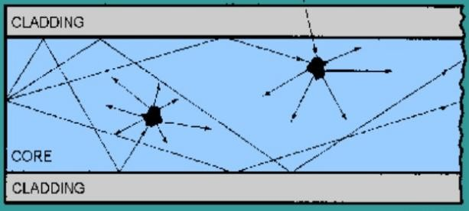
MIE Scattering
Linear scattering also occurs at inhomogenities and these arise from imperfections in the fibre's geometry, irregularities in the refractive index and the presence of bubbles etc. caused during manufacture.
Careful control of manufacturing process can reduce MIE scattering to
insignificant levels.
Fig. Linear Scattering

Slide 19
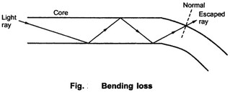
Bending Losses
The loss which exists when an optical fiber undergoes bending is called bending loss.
Losses due to curvature and losses caused by an abrupt change in radius of
curvature are referred to as bending losses.
The sharp bend of a fiber causes significant radiative losses and there is
also possibility of mechanical failure. This is shown in Fig.
As the core bends, the normal will follow it and the ray will now find itself on the wrong side of critical angle and will escape. The sharp bends are therefore avoided.

Slide 20
The radiation loss from a bent fiber depends on:
Field strength where power is lost through radiation.
The radius of curvature R.
The higher order modes are less tightly bound to the fiber core, the higher order modes radiate out of fiber firstly.
For multimode fiber, the effective number of modes that can be guided by curved fiber is given expression :
where,
α is graded index profile. difference.
n2 is refractive index of cladding.
Δ is core – cladding index
k is wave propagation constant .

Slide 21
n K a 
N∞ is total number of modes in a straight fiber.
α
α + 2
N =
2
∞
1
Bending the fiber also causes attenuation.
Bending loss is classified according to the bend radius of curvature: Microbend loss or Macrobend loss.

Slide 22
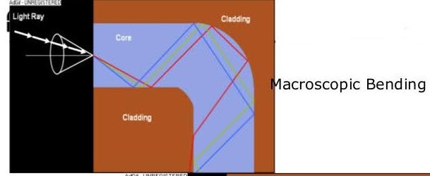
Macrobend losses : Bending in which complete fiber undergoes bends
which causes certain modes not to be reflected .
These losses are observed when a fiber bend's radius of curvature is large compared to the fiber diameter.
Fiber sensitivity to bending losses can be reduced.
If the refractive index of the core is increased, then fiber sensitivity decreases. Sensitivity also decreases as the diameter of the overall fiber increases.
However, increases in the fiber core diameter increase fiber sensitivity. Fibers with larger core size propagate more modes. These additional modes tend to be more lossy.
For slight bends, the loss is extremely
and is not observed.
small

Slide 23
Microbending: This is a loss due to small bending or distortions. This small microbending is not visible. The losses due to this are temperature related, tensile related or crush related.
The effects of microbending on multimode fiber can result in increasing attenuation. These effects can be minimized during installation and testing.

Slide 24
Core & Cladding Losses
Since the core and cladding have different indices of refraction hence they have different attenuation coefficients α1 and α2 respectively.
For step index fiber, the loss for a mode order (v, m) is given by,
For low-order modes, the expression reduced to
where P_{core}/P and P_{cladding}/P are fractional powers

Slide 25
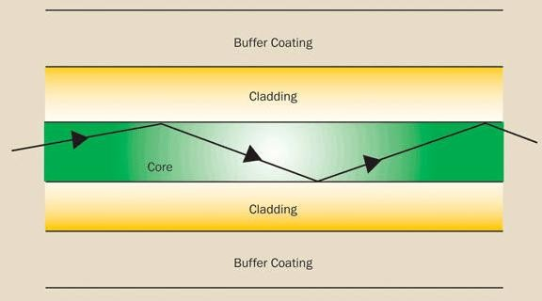
For graded index fiber, loss at radial distance is expressed as,
The loss for a given mode is expressed by,
where, P(r) is power density of that model at radial distance r.

Slide 26
Signal Distortion in Optical Waveguide
The pulse get distorted as it travels along the fiber lengths.
Pulse spreading in fiber is referred as dispersion.
Dispersion is caused by difference in the propagation times of light rays that takes different paths during the propagation.
The light pulses travelling down the fiber encounter dispersion effect because of this the pulse spreads out in time domain.
Dispersion limits the information bandwidth. The distortion effects can be analyzed by studying the group velocities in guided modes.
Information Capacity Determination
Dispersion and attenuation of pulse travelling along the fiber is shown in Fig

Slide 27
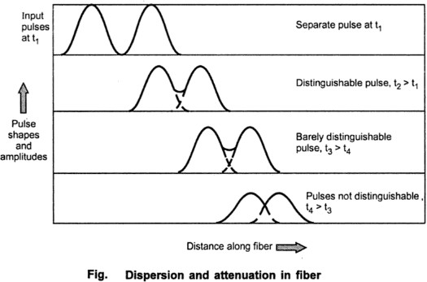
Fig. shows, after travelling some distance, pulse starts broadening and overlap with the neighbouring pulses.
At certain distance the pulses are not even distinguishable and error will occur at receiver. Therefore the information capacity is specified by bandwidth- distance product (MHz . km). For step index bandwidth distance product is 20 MHz . km and for graded index it is 2.5 MHz . km.

Slide 28
Phase Velocity

Slide 29
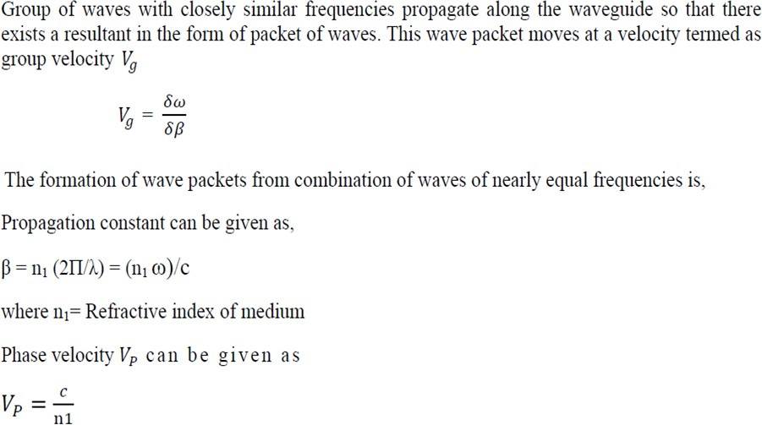
Group Velocity

Slide 30
Group Delay
Consider a fiber cable carrying optical signal equally with various modes and each mode contains all the spectral components in the wavelength band.
All the spectral components travel independently and they observe different time delay and group delay in the direction of propagation.
The velocity at which the energy in a pulse travels along the fiber is known as group velocity. Group velocity is given by,
₌ ∂ω
V
g
∂β
Thus different frequency components in a signal will travel at different group velocities and so will arrive at their destination at different times, for digital modulation of carrier, this results in dispersion of pulse, which affects the maximum rate of modulation.

Slide 31
t  ^{d} .
Let the difference in propagation times for two side bands is δτ.
dλ
Derivation is here

Slide 32
Dispersion in Optical Fiber
In communication, dispersion is used to describe any process by which any electromagnetic signal propagating in a physical medium is degraded because the various wave characteristics (i.e., frequencies) of the signal have different propagation velocities within the physical medium.
The pulse gets distorted as it travels along the fiber lengths. Pulse spreading in fiber is referred as dispersion.
Dispersion is caused by difference in the propagation times of light rays that takes different paths during the propagation. The light pulses travelling down the fiber encounter dispersion effect because of this the pulse spreads out in time domain. Dispersion limits the information bandwidth.
The distortion effects can be analyzed by studying the group velocities in guided modes. There are two types of Dispersion:
Intra modal Dispersion: Dispersion is single mode fibers Inter Modal Dispersion: Dispersion in Multirnode Fibers.

Slide 34
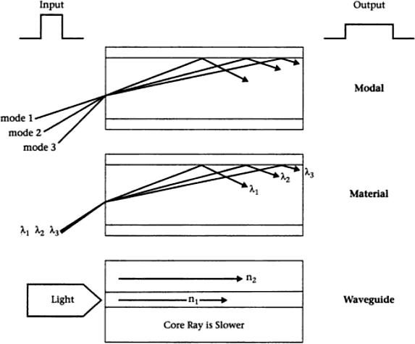

Slide 35
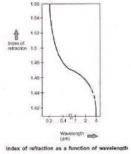
Material Dispersion
Material dispersion exists due to change in index of refraction for different wavelengths. A light ray contains components of various wavelengths centered at wavelength λ₀.
The time delay is different for different wavelength components. This results in time dispersion of pulse at the receiving end of fiber. Fig. shows index of refraction as a function of optical wavelength.

Slide 36
The unit of dispersion is: ps/nm/Km. The amount of material dispersion
depends upon the chemical composition of glass.
The pulse spreading in nm/Km is given by : σ_{m}= σ L M
Where,
L=1m (Normalized distance)
σ = Spectral width in nm
M= Material Dispersion=D_{mat}
Expression for Material Dispersion
Consider a fiber cable carrying optical signal equally with various modes and each mode contains all the spectral components in the wavelength band. All the spectral components travel independently and they observe different time delay and group delay in the direction of propagation. The velocity at which the energy in a pulse travels along the fiber is known as group velocity. Group velocity is given by,

Slide 37
- Angular Frequency
Β – Propagation Constant
₌ dω
V
g
dβ
Thus different frequency components in a signal will travel at different group velocities and so will arrive at their destination at different times, for digital modulation of carrier, these results in dispersion of pulse, which affects the maximum rate of modulation.
Let the difference in propagation times for two side bands is δt.
Derivation is here

Slide 38
Waveguide Dispersion
Waveguide dispersion is only important in single mode fibers. It is caused by the fact that some light travels in the fiber cladding compared to most light travels in the fiber core
Since fiber cladding has lower refractive index than fiber core, light ray that travels in the cladding travels faster than that in the core. Waveguide dispersion is also a type of chromatic dispersion. It is a function of fiber core size, V-number, wavelength and light source line width.
While the difference in refractive indices of single mode fiber core and cladding are minuscule, they can still become a factor over greater distances.
Waveguide dispersion is significant only in fibers carrying fewer than 5-10 modes. Since multimode optical fibers carry hundreds of modes, they will not have observable waveguide dispersion.

Slide 39
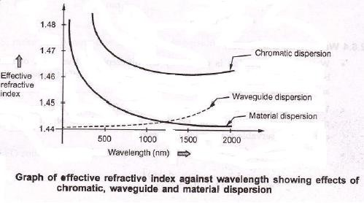
Chromatic Dispersion
The combination of material dispersion and waveguide dispersion is called chromatic dispersion.
A graph of effective refractive index against wavelength illustrates the
effects of material, chromatic and waveguide dispersion.
Material dispersion and waveguide
dispersion effects vary in vary in
opposite senses as the wavelength increased, but at an optimum wavelength around 1300 nm, two effects almost Cancel each other and chromatic dispersion is at minimum.

Slide 40
Modal Dispersion
Dispersion caused by multipath propagation of light energy is referred to as intermodal dispersion.
Multimode fibers can guide many different light modes since they have much larger core size. Each mode enters the fiber at a different angle and thus travels at different paths in the fiber.
Since each mode ray travels a different distance as it propagates, the ray arrive at different times at the fiber output. So the light pulse spreads out in time which can cause signal overlapping so seriously that you cannot distinguish them any more.
Model dispersion is not a problem in single mode fibers since there is only one mode that can travel in the fiber.
It is broadly noticed into two types:
Intramodal dispersion
Intermodal dispersion

Slide 41
Intermodal Dispersion
Pulse broadening due to intermodal dispersion (sometimes referred to simply as modal or mode dispersion) results from the propagation delay differences between modes within a multimode fiber.
As the different modes which constitute a pulse in a multimode fiber travel along the channel at different group velocities, the pulse width at the output is dependent upon the transmission times of the slowest and fastest modes.
Multimode step index fibers exhibit a large amount of intermodal
dispersion which gives the greatest pulse broadening.
The overall pulse broadening in multimode graded index fibers is far less than that obtained in multimode step index fibers (typically by a factor of 100). Thus graded index fibers used with a multimode source give a tremendous bandwidth advantage over multimode step index fibers.

Slide 42
Using the ray theory model, the fastest and slowest modes propagating in the step index fiber may be represented by the axial ray and the extreme meridional ray (which is incident at the core–cladding interface at the critical angle φ_{c})
As both rays are travelling at the same velocity within the constant refractive index fiber core, then the delay difference is directly related to their respective path lengths within the fiber.
Hence the time taken for the axial ray to travel along a fiber of length L gives the minimum delay time T_{Min} and:
(1)
where n₁ is the refractive index of the core and c is the velocity of light in a vacuum.

Slide 43
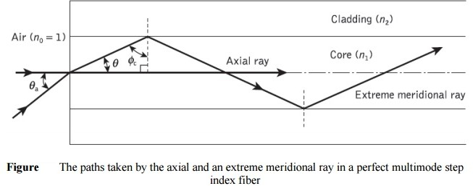
The extreme meridional ray exhibits the maximum delay time T_{Max} where:
(2)
Using Snell’s law of refraction at the core–cladding interface
(3)

Slide 44
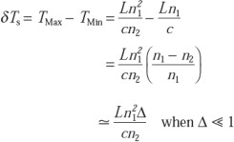
where n₂ is the refractive index of the cladding. Furthermore, substituting
Eq. 3 into Eq. 2 for cosθ gives:
(4)
The delay difference δTs between the extreme meridional ray and the axial ray may be obtained by:
(5)
(6)

Slide 45
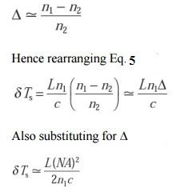
where NA is the numerical aperture for the fiber.

Slide 46
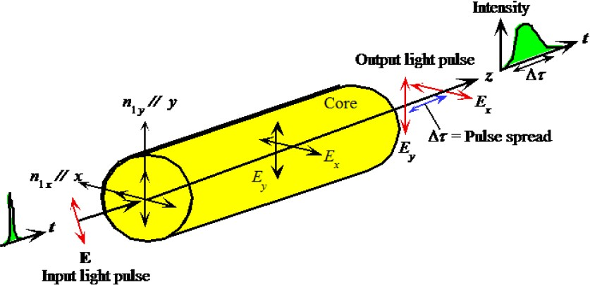
Polarization Mode Dispersion
Suppose that the core refractive index has different values along two orthogonal directions corresponding to electric field oscillation direction (polarizations). We can take x and y axes along these directions. An input light will travel along the fiber with E_{x} and E_{y} polarizations having different group velocities and hence arrive at the output at different times.

Slide 47
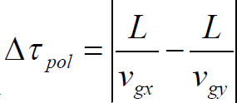
The effects of fiber-birefringence on the polarization states of an optical
are another source of pulse broadening.
Polarization mode dispersion (PMD) is due to slightly different velocity for each polarization mode because of the lack of perfectly symmetric & anisotropicity of the fiber.
If the group velocities of two orthogonal polarization modes are v_{gx} and v_{gy} then the differential time delay between these two polarization over a distance L is
PMD is the limiting factor for optical communication system at high data rates. The effects of PMD must be compensated.

Slide 48
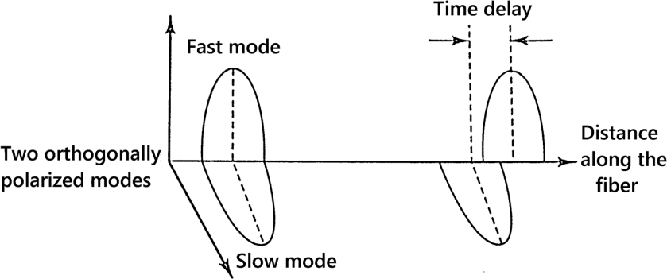

Slide 49
Pulse Broadening in GI Fibers
The core refractive index varies radially in case of graded index fibers, hence it supports multimode propagation with a low intermodal delay distortion and high data rate over long distance is possible.
The higher order modes travelling in outer regions of the core, will travel faster than the lower order modes travelling in high refractive index region.
If the index profile is carefully controlled, then the transit times of the individual modes will be identical, so eliminating modal dispersion.
The r.m.s pulse broadening is given as :
]1/ 2
σ = [σ +σ
2
Inter mod al
2
Intramodal
σ_{intermodal} – R.M.S pulse width due to intermodal delay distortion
σ_{intramodal} – R.M.S pulse width due to intramodal delay distortion

Slide 50
… The intermodal delay and pulse broadening are related by expression
given by Personick.
₂ ₎1/ 2
= ( τ_{g} − τ
2
g
where τ_{g} - group-delay
^{σ}int er modal
From this expression for intermodal pulse broadening is given as:
16Δ²c ² (α +1)²
⎤1/ 2
LN Δ α
( )
1/ 2
⎡
4c c (α +1)Δ
=
1 α
+ 2
× ⎢c ²
₊ 1 2 ₊ 2 ⎥
^{σ} int er mod al
2c
α +1 3α + 2
1
2α +1
(5α + 2)(3α + 2) ⎥⎦
⎣⎢
_{c =} α − 2 − ε
_{c =} 3α − 2 − 2ε
1
α + 2
2
2(α + 2)

Slide 51
 
To find the intramodal pulse broadening, we use the definition
_{σ} 2
( )
2
2
= L
2
σ
λ
λ
dτ
g
int ra mod al
λ
dλ
Where σ_{λ} is the rms spectral width of the optical source.
⎡
2
⎛
⎞⎤
⎟⎥
1/ 2
L σ
⎛ d ²n ⎞
d ²n
α
α +1
2α
σ
=
λ _{⎢⎜ −λ} 2 1 ⎟
⎜
λ
2
N c Δ 2
1
dλ ²
− N Δ
−
int ra mod al
c λ ⎢⎝
dλ ² ⎠
1 1
⎜
1
3α + 2
⎟⎥
⎣
⎝
⎠⎦

Slide 52
Fiber Connectors
Connectors are mechanisms or techniques used to join an optical fiber to another fiber or to a fiber optic component.
Different connectors with different characteristics, advantages,
disadvantages and performance parameters are available. Suitable
connector is chosen as per the requirement and cost.
Various fiber optic connectors from different manufactures are available SMA 906, ST, BOCONIC, FC, D4, HMS-10, SC, FDDI, ESCON, LC, MT etc.
Three different types of connectors are used for connecting fiber optic
cables. They are:
subscriber Channel (SC) Connector
Straight Tip (ST) Connector
Mechanical Transfer – Registered Jack (MT-RJ)

Slide 53
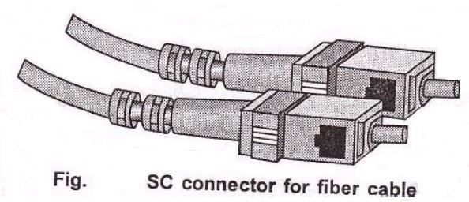
SC Connectors are general purpose connectors. It has push-pull type locking system.

Slide 54
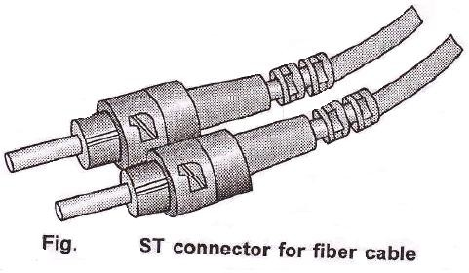
ST connectors are most suited for networking devices. It is more reliable than SC connector. ST connector has bayonet type locking system. Fig. shows ST connectors.

Slide 55
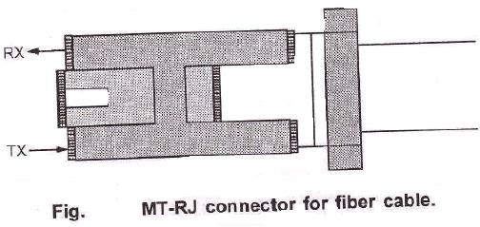
MT-RJ connector is similar to RJ45 connector. Fig. shows MT-RJ connector

Slide 56
Principles of Good Connector Design
Low coupling loss.
Inter-changeability – No variation in loss whenever a connector is
applied to a fiber.
Ease of assembly.
Low environmental sensitivity.
Low cost – The connector should be in expensive also the tooling required for fitting.
Reliable operation.
Ease of connection.
Repeatability – Connection and reconnection many times without an
increase in loss.

Slide 57
Connector Types
Connectors use variety of techniques for coupling such as screw on, bayonet-mount, push-pull configurations, butt joint and expanded beam fiber connectors.
Butt Joint Connectors
Fiber is epoxied into precision hole and ferrules are used for each fiber. The fibers are secured in a precision alignment sleeve. Butt joints are used for single mode as well as for multimode fiber systems.
Two commonly used butt-joint alignment designs are:
Straight-Sleeve.
Tapered-Sleeve/Biconical.

Slide 58
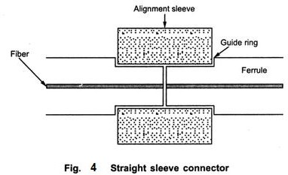
In straight sleeve mechanism, the length of the sleeve and guided ferrules determines the end separation of two fibers. Fig. shows straight sleeve alignment mechanism of fiber optic
connectors.

Slide 59
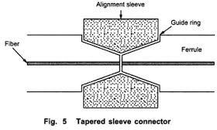
In tapered sleeve or biconical connector mechanism, a tapered sleeve is used to accommodate tapered ferrules. The fiber end separations are determined by sleeve length and guide rings. Fig. shows tapered sleeve fiber connectors.

Slide 60
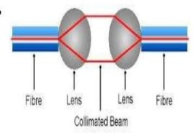
Expanded Beam Connector
It employs lenses on the ends of the fibers
These lenses either collimate the light from transmitting fiber or focus
the expanded beam onto the core of the receiving filter
Filter to lens distance = Focal length
Advantages
Connector is less dependent on lateral alignments
Beam splitters and switches can be easily inserted into expanded
beam between fiber ends.

Slide 61
Connector Return Loss
The amount of power reflected from the connector to connector
interface. Return Loss values are expressed as dB.
A typical specification could Range from -15 to -60 dB, where, in most
cases, -60 is more desirable.
At the connection point of optical link, low reflectance levels are desired since the optical reflections can be the source of unwanted feedback into laser cavity.
Due to this unwanted feedback the optical frequency response may degrade, also it generates internal noise with the source affecting overall system performance.

Slide 62
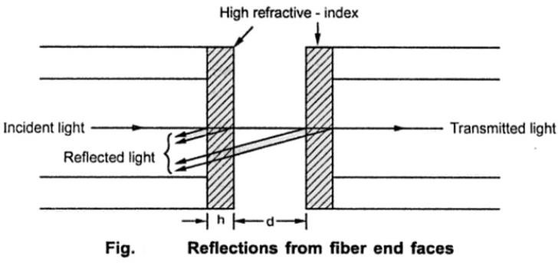
The return loss for the index-matched gap region is given by,
Where,
d is the separation between fiber end.
n₁ is index-matching material. R is reflectivity constant.

