Slide 1
SIGNAL AND SYSTEM

Slide 2
General Introduction
What are they?
Signal
System

Slide 3
Fundamentals of Signals and Systems
Signal: a function of one or more variables that convey information on the nature of a physical phenomenon.
Examples: v(t),i(t),x(t),heartbeat, blood pressure, temperature, vibration.
One-dimensional signals: function depends on a single variable, e.g., speech signal
Multi-dimensional signals: function depends on two or more variables, e.g., image

Slide 4
Fundamentals of Signals and Systems
System: an entity or operator that manipulates one or more signals to accomplish a function, thereby yielding new signals.
Commonly encountered systems: communications systems
Automatic speaker recoginition system
Aircraft landing system
.
Input signal
Output signal
System

Slide 5
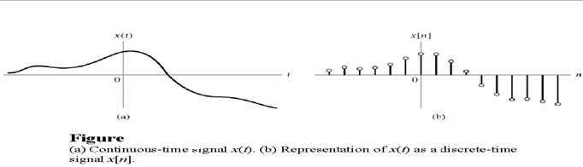
1. CT and DT signals:
Classification of signals

Slide 6
Classification of signals (cont.)
For many cases, x[n] is obtained by sampling x(t) as:
x[n] = x(nT) , n =0,+1,+2,…
Are there any requirements for the sampling?

Slide 7
Classification of signals (cont.)
2. Even and odd signals:
Even:
x(−t) = x(t)
x[−n] = x[n]
Odd:
x(−t) = −x(t)
x[−n] = −x[n]
Any signal x(t) can be expressed as
x(t) = xe(t) + xo(t) )
x(−t) = xe(t) − xo(t)
where
xe(t) = 1/2(x(t) + x(−t))
xo(t) = 1/2(x(t) − x(−t))

Slide 8
Classification of signals (cont.)
3. Periodic and non-periodic signals:
CT signal: if x(t) = x(t + T), then x(t) is periodic.
Smallest T=Fundamental period: To
Fundamental frequency fo = 1/To (Hz or cycles/second)
Angular frequency: o = 2 /To (rad/seconds)
DT signal: if x[n] = x[n + N], then x[n] is periodic.
min(No): fundamental period
Fo = 1/No (cycles/sample)
=2 /N (rads/sample). If the unit of n is designated as dimensionless,
then is simply in radians.
Note: A sampled CT periodic signal may not be DT periodic.
Any Condition addition of two periodic CT signals, resultant must be periodic signal ?

Slide 9
Classification of signals (cont.)
4. Deterministic and random signals.
Deterministic signal: No uncertainty with respect to its value at any time
Completely specified at any time
Random signal: Uncertain before it occurs. E.g., thermal noise.

Slide 10
Classification of signals (cont.)
Energy and power signals:
CT signal x(t):
Energy: E =
Power: P =

Slide 11
Classification of signals (cont.)
DT signal x[n]:
Energy: E =
Power:
Energy signal: if 0 < E <
Power signal: if 0 < P <

Slide 12
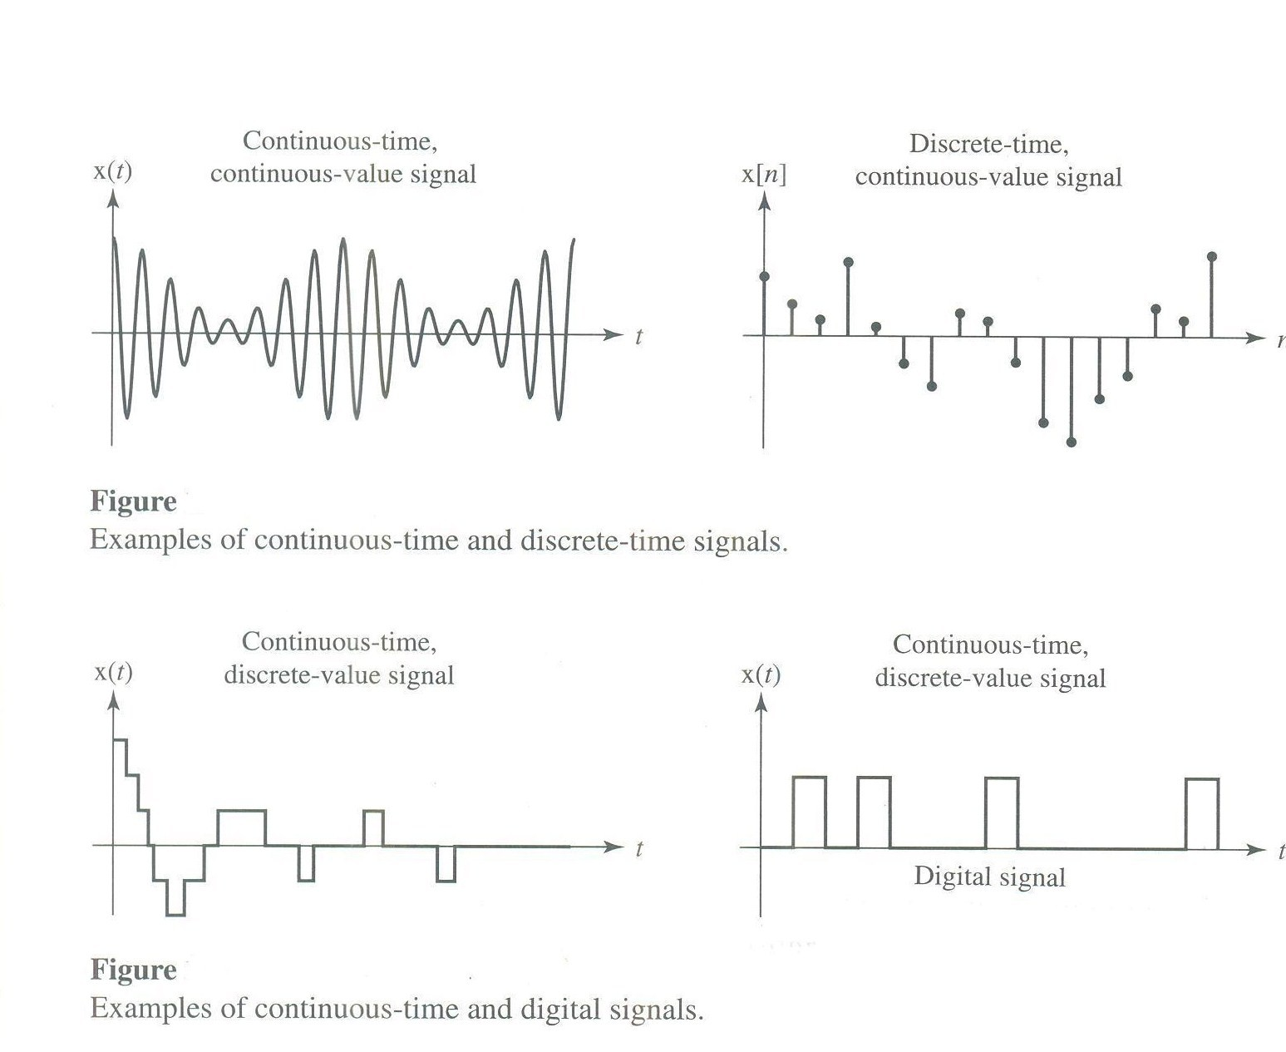
Classification of signals (cont.)
Analog Signal and Digital Signal

Slide 13
Basic operations on signals
Basic Operations on Signal

Slide 14
Rule for time shifting and time scaling:
See figure below. Find y(t) = x(2t + 3).
Basic Operations on Signal(cont.)

Slide 15
Elementary signals
1. Exponential
2-Sinusoidal

Slide 16
Elementary signals(cont.)
3. Step function

Slide 17
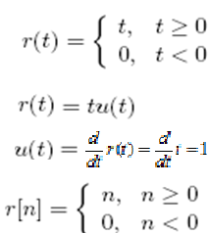
Elementary signals(cont.)
4.Unit impulse function
5.Unit ramp function

Slide 18
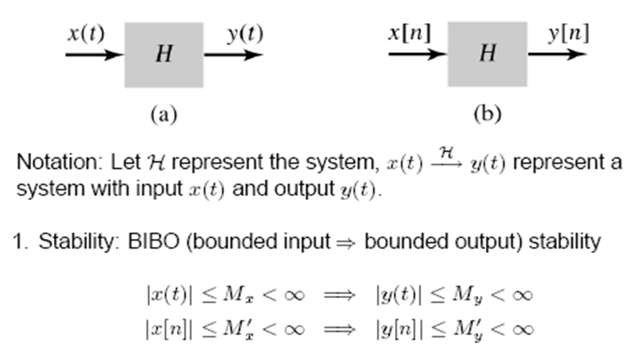
System Properties

Slide 19
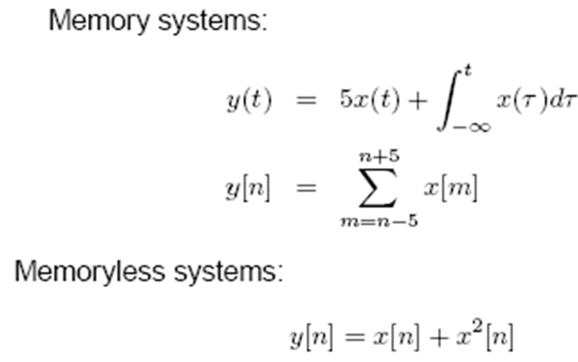
2.Memory /Memoryless
Memory system: present output value depend on future/past input.
Memoryless system: present output value depend only on present input.
Example
System Properties(cont.)

Slide 20
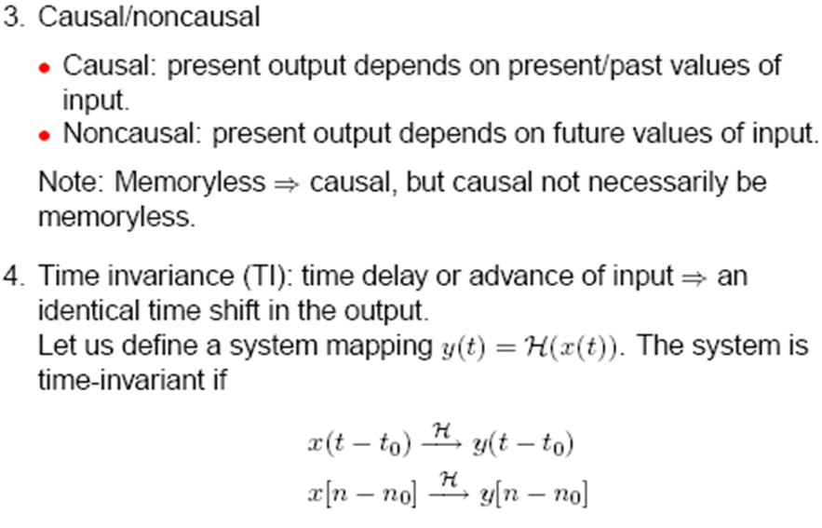
System Properties(cont.)

Slide 21
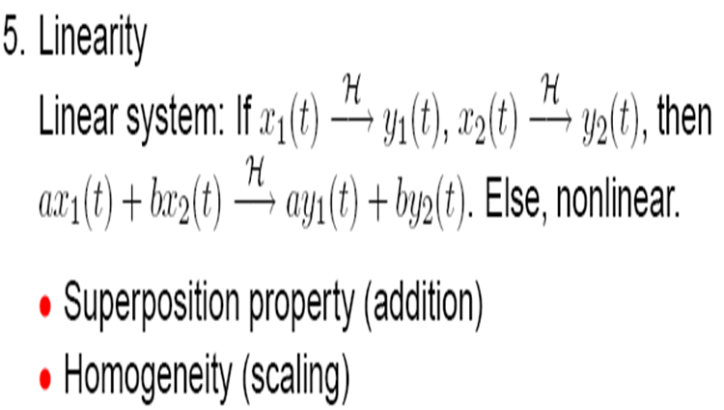
System Properties(cont.)

Slide 22
Invertibility
y(t)
x(t)
x(t)
H
H
System Properties(cont.)

Slide 23
Series(cascade) Interconnection
Parallel, Interconnection
System 1
System 2
Input
Output
System 1
Input
Output
+
System 2
Interconnection of systems

Slide 24
Feedback Interconnection
Input
Output
System 1
System 2
Interconnection of systems

